Slide 1
Apriori Algorithm

Slide 2
The Apriori Algorithm is an influential algorithm for mining frequent itemsets for boolean association rules.
Key Concepts :
Frequent Itemsets: The sets of item which has minimum support (denoted by L_{i} for ith-Itemset).
Apriori Property: Any subset of frequent itemset must be frequent.
Join Operation: To find L_{k} , a set of candidate k-itemsets is generated by joining L_{k-1} with itself.

Slide 3
The Apriori Algorithm
Join Step: C_{k} is generated by joining L_{k-1}with itself
Prune Step: Any (k-1)-itemset that is not frequent cannot be a subset of a frequent k-itemset
Pseudo-code:
C_{k}: Candidate itemset of size k
L_{k} : frequent itemset of size k
L₁ = {frequent items};
for ( k = 1; L_{k} != ∅; k++) do begin
C_{k+1} = candidates generated from L_{k};
for each transaction t in database do increment the count of all candidates in C_{k+1} that are contained in t
L_{k+1} = candidates in _{Ck+1} with min_support
End
return ∪_{k} L_{k};

Slide 4
EXAMPLE
Transaction | Item
T1 | I1, I2, I5
T2 | I2, I4
T3 | I2, I3
T4 | I1, I2, I4
T5 | I1, I3
T6 | I2, I3
T7 | I1, I3
T8 | I1, I2 ,I3, I5
T9 | I1,I2,I3

Slide 5
Consider a database D
consisting of 9 transactions.
Suppose min. support count required is 2 (i.e. min_sup = 2/9 = 22 % )
Let minimum confidence required is 70%.
We have to first find out the frequent itemset using Apriori algorithm.
• Then, Association rules will be generated using min. support & min. confidence.

Slide 6
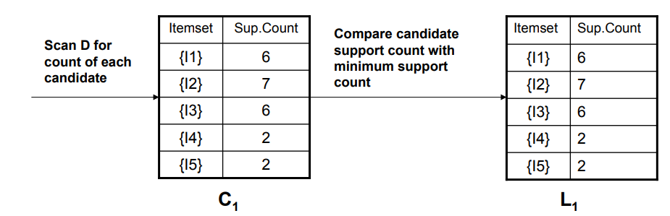
Step 1: Generating 1-itemset Frequent Pattern

Slide 7
The set of frequent 1-itemsets, L₁ , consists of the candidate 1- itemsets satisfying minimum support.
In the first iteration of the algorithm, each item is a member of the set of candidate.

Slide 8
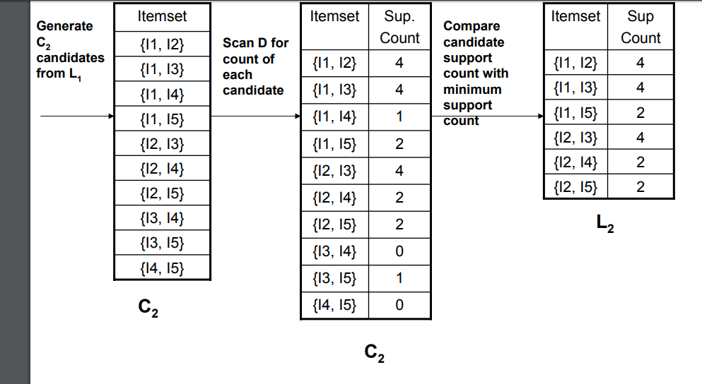
Step 2: Generating 2-itemset Frequent Pattern

Slide 9
To discover the set of frequent 2-itemsets, L₂ , the algorithm uses L₁ Join L₁ to generate a candidate set of 2-itemsets, C₂.
•Next, the transactions in D are scanned and the support count for each candidate itemset in C₂is accumulated (as shown in the middle table).
The set of frequent 2-itemsets, L₂ , is then determined, consisting of those candidate 2-itemsets in C2 having minimum support.

Slide 10
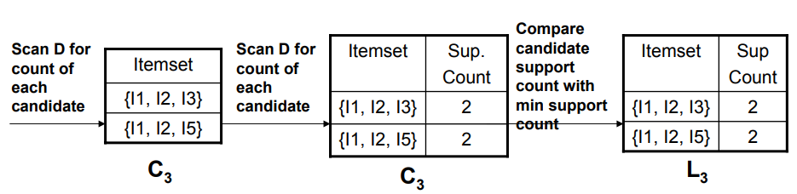
Step 3: Generating 3-itemset Frequent Pattern

Slide 11
The generation of the set of candidate 3-itemsets, C3 , involves use of the Apriori Property.
• In order to find C3, we compute L2 Join L2.
C3 = L2 Join L2 = {{I1, I2, I3}, {I1, I2, I5}, {I1, I3, I5}, {I2, I3, I4}, {I2, I3, I5}, {I2, I4, I5}}.

Slide 12
Step 4: Generating 4-itemset Frequent Pattern
The algorithm uses L3 Join L3 to generate a candidate set of 4-itemsets, C4.
Although the join results in {{I1, I2, I3, I5}}, this itemset is pruned since its subset {{I2, I3, I5}} is not frequent. •
Thus, C4 = φ , and algorithm terminates, having found all of the frequent items. This completes our Apriori Algorithm.

Slide 13
Generating Association Rules from Frequent Itemsets
Let minimum confidence threshold is , say 70%.
The resulting association rules are shown below, each listed with its confidence. – R1: I1 ^ I2 -> I5
Confidence = sc{I1,I2,I5}/sc{I1,I2} = 2/4 = 50% •
R1 is Rejected.
R2: I1 ^ I5 ->I2 •
Confidence = sc{I1,I2,I5}/sc{I1,I5} = 2/2 = 100%
R2 is Selected.
R3: I2 ^ I5 -> I1
• Confidence = sc{I1,I2,I5}/sc{I2,I5} = 2/2 = 100%
R3 is Selected.

Slide 14
R4: I1 -> I2 ^ I5
Confidence = sc{I1,I2,I5}/sc{I1} = 2/6 = 33%
R4 is Rejected.
R5: I2 ->I1 ^ I5
Confidence = sc{I1,I2,I5}/{I2} = 2/7 = 29%
R5 is Rejected.
R6: I5-> I1 ^ I2
Confidence = sc{I1,I2,I5}/ {I5} = 2/2 = 100%
R6 is Selected.
In this way, We have found three strong association rules

Slide 15
Association Rules
When we go grocery shopping, we often have a standard list of things to buy.
Each shopper has a distinctive list, depending on one’s needs and preferences.
A housewife might buy healthy ingredients for a family dinner, while a bachelor might buy beer and chips.
Understanding these buying patterns can help to increase sales in several ways.
If there is a pair of items, X and Y, that are frequently bought together:
Both X and Y can be placed on the same shelf, so that buyers of one item would be prompted to buy the other.
Promotional discounts could be applied to just one out of the two items.
Advertisements on X could be targeted at buyers who purchase Y.
X and Y could be combined into a new product, such as having Y in flavors of X.

Slide 16
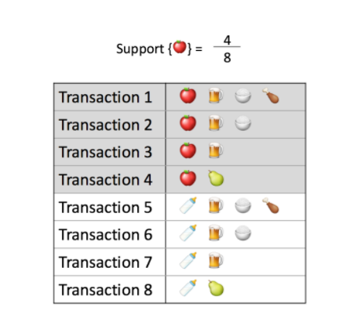
Association rules analysis is a technique to uncover how items are associated to each other. There are three common ways to measure association.
Measure 1: Support. This says how popular an itemset is, as measured by the proportion of transactions in which an itemset appears.
In Table 1 below, the support of {apple} is 4 out of 8, or 50%. Itemsets can also contain multiple items. For instance, the support of {apple, beer, rice} is 2 out of 8, or 25%.

Slide 17
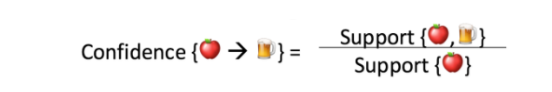
Measure 2: Confidence.]
This says how likely item Y is purchased when item X is purchased, expressed as {X -> Y}. This is measured by the proportion of transactions with item X, in which item Y also appears.
In Table 1, the confidence of {apple -> beer} is 3 out of 4, or 75%

Slide 18
tASK
TRANSACTION | iTEM
T1 | M,O,N,K,E,Y
T2 | D,O,N,K,E,Y
T3 | M,A,K,E
T4 | M,U,C,K,E
T5 | C,O,O,K,E
MIN SUPPORT=70%
MIN-CONFIDENCE=80%

Slide 19
Lab task
Transaction | Item
1 | I1,I3,I4
2 | I2,I3,I5
3 | I1,I2,I3,I5
4 | I2,I5
Minimum support:2
Minimum confidence:70%

Slide 20
ID | MIlk | Bread | Butter | beer
1 | 1 | 1 | 0 | 0
2 | 0 | 1 | 1 | 0
3 | 0 | 0 | 0 | 1
4 | 1 | 1 | 1 | 0
5 | 0 | 1 | 0 | 0
6 | 1 | 0 | 0 | 0
7 | 0 | 1 | 1 | 1
8 | 1 | 1 | 1 | 1
9 | 0 | 1 | 0 | 1
10 | 1 | 1 | 0 | 0
11 | 1 | 0 | 0 | 0
12 | 0 | 0 | 0 | 1
13 | 1 | 1 | 1 | 0
14 | 1 | 0 | 1 | 0
15 | 1 | 1 | 1 | 1
Min support:4
Min conf:70%

